Slide 1
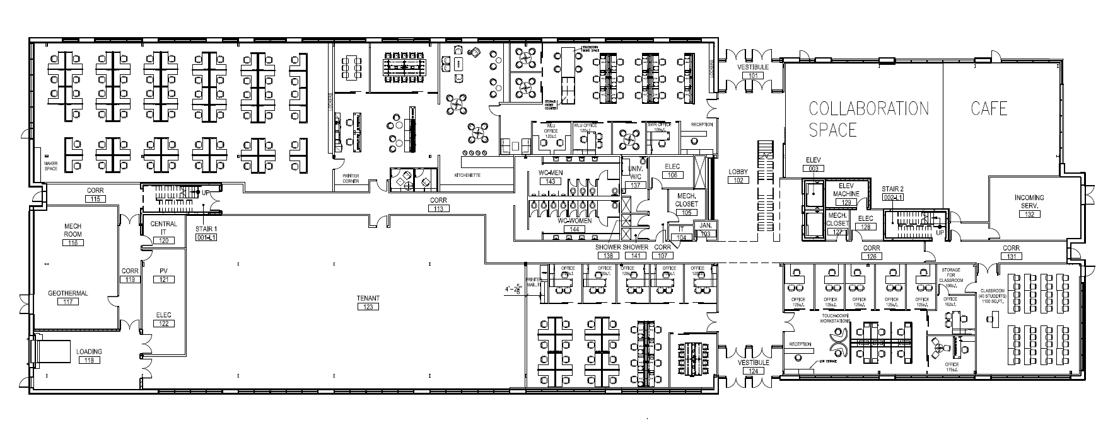
B
EG7
EG6
EG1
L7
L1
SR1
AC1
L6
EG2
LO3
H5
H7
EG5
SR2
EG4
L5
L4
L3
L2
AC2
EG3
D
H1
WC
LO2
SR3
H2
H3
H4
C
V7
V6
V5
V4
V3
LO1
W2
W3
W4
W5
W6
H6
W7
WW1
W1
V1
W8
V2
A

Slide 2
NODES:
Social/Relax:
SS1-3
EG1-2, 4-5
Kitchen:
EG3
Washrooms:
WC
Workstations:
AC1-2
L1-7
W1-8
V1-7
EG6-7
Outside:
A, B, C
Other:
H1-6
L1-3
WW1
A,B,C: outside
L1-3: Lobby
H1-6: Hallways
WC: Washrooms
AC1-2: Accelerator center
EG1-7: evolvGreen
L1-7: Laurier
SS1-3: Cora + cafe
W1-8: UW center 1
V1-7: UW center 2
WW1: UW classroom

